Slide 1
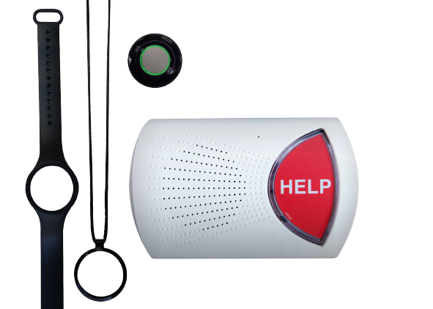
HeartSafe Monitoring device
Chantal Johnson

Slide 2
Business proposal
This proposal outlines a plan for the production of two medical alert systems. We currently manufacture the HeartSafe device which monitors heart conditions.
We have a second product the SmartSafe system which expands on the capabilities of the HeartSafe system.
Here we present a rational for the production of both the HeartSafe and SmartAlert monitoring devices in combination to maximise company profits.

Slide 3
Business problem
Our production can produce:
200 Type X ( HeartSafe) devices per hour
140 Type Y (SmartAlert) devices per hour
Maximum 6000 Type X devices per week
Maximum 4000 Type Y devices per week.
40 available hours per week
Profit per Type X device: $25
Profit per Type Y device: $30.
Using this information we can decide on the numbers of devices to produce and see if it is more profitable to produce only one type of monitoring system or a combination of both.

Slide 4
Business problem
Profit from only HeartSafe (Type X) production:
Producing the maximum 6000 devices at $25 each: $150000
Profit from only SmartAlert (Type Y) production:
Producing the maximum 4000 devices at $30 each: $120000

Slide 5
Optimization problem
Decision variables:
Type X (HeartSafe) devices to produce
Type Y (SmartAlert) devices to produce
Objective function:
Maximise: 25X + 30Y
Constraints:
Hourly production capacity: X/200 + Y/140 <= 40
Type X capacity: X <= 6000
Type Y capacity: Y <= 4000
We are using excel to commute this optimization due to it's ease and simplicity. The optimization will also be simple to set up and make changes to. Excel file attached separately.

Slide 6
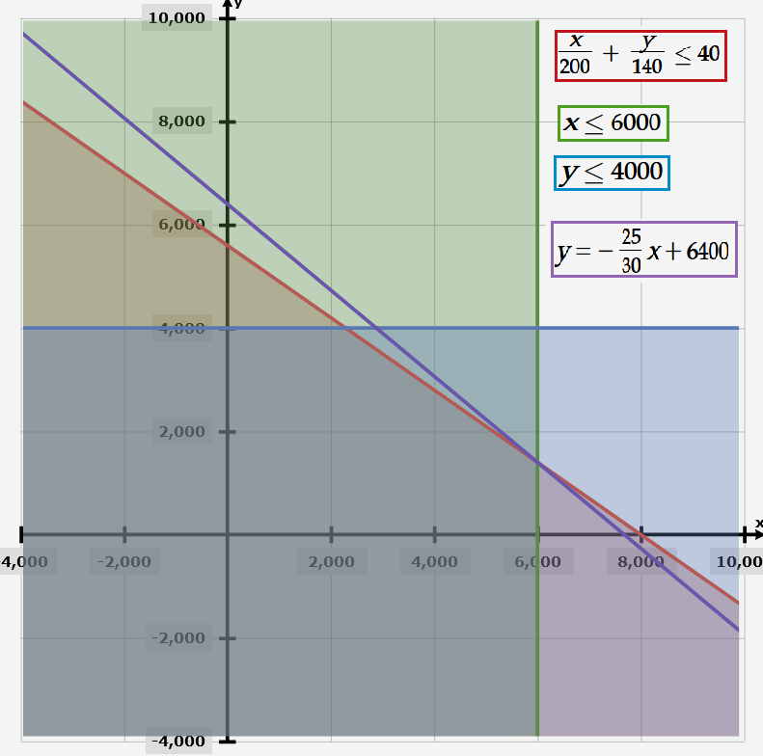
Results
Excel linear programming optimization produces the optimal solution:
# Type X to produce: 6000
# Type Y to produce: 1400
Profit: $192000
Leftover Resources:
Hourly production capacity slack: 0
Type X capacity: 0
Type Y capacity: 2600
We should produce 6000 HeartSafe devices and 1400 SmartAlert devices achieving a profit of $192000.
Fig 1 Graph of linear optimization.

Slide 7
Additional Considerations
Defects in production
Defected products lose money. To minimize this, we should perform routine inspection of our devices. An acceptable quality limit of 2.5% will be used, meaning that if more than 2.5% of a given batch have defects we need to review the production process.
Demand/supply
Steps to be taken to prevent over production of devices will include monitoring market demand to ensure the products are priced appropriately.
We should also monitor the production takt and cycle times to ensure that we are able to produce devices at a rate inline with customer demand.

Slide 8
Additional Considerations
Competition
There are many strategies we can take to address competitor products. Performing competitor analysis will enable use to assess our own business model to ensure that we are achieving similar or better levels of profitability.
As we are selling a device with specific uses, it would be good to complete a customer profile to identify who we should be marketing to. For example, we could use surveys, focus groups or analysis of social media responses.

Slide 9
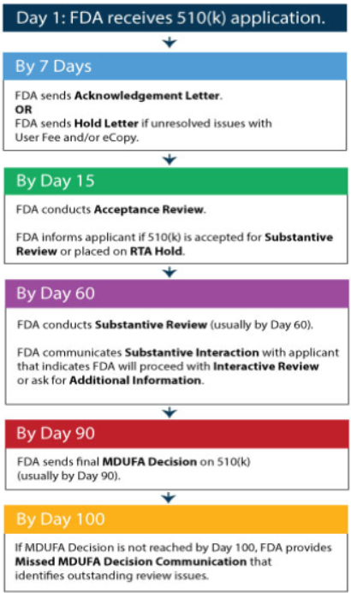
Additional Considerations
FDA Regulation
SmartAlert would be classified as a class II medical device meaning it will require Premarket Notification 510(k) clearance prior to going to market.
This involves providing evidence that the our products are as safe as pre-existing products.
Has a 90 day time-frame which will need to be accounted for in initial production schedules.
Fig 2: Timeline for FDA Premarket clearance

Slide 10
Conclusion
We should used a production schedule that involves producing 6000 HeartAlert devices and 1400 SmartAlert devices to achieve maximum profits.

Slide 11
Further Questions
Sharing of components for production
Production efficiency and times could be improved if both devices were composed of the same same components.
Increasing storage capacity / hourly production capacity
To increase potential profits we could seek to increase separately or in combination the storage capacity of devices or the amount produced per hour.

